Slide 1
01
Panel Discussion #73
Making Mighty Moves: Overcoming Imposter Syndrome One Present Moment at a Time
#ACBSWC

Slide 2
02
Introduction
#ACBSWC

Slide 3
Imposter Syndrome
03
DEFINED
A pattern of behavior where individuals doubt their competence and have a persistent fear of being exposed as a fraud
PREVALENCE
Estimated to affect 70% of people at some point in their lives
#ACBSWC
WHO IT AFFECTS
Typically high achievers who are unable to internalize successes and attribute accomplishments to external factors (e.g., luck) rather than abilities
More common in women and minorities

Slide 4
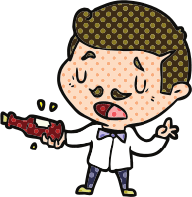
04
Five Subtypes
THE SUPERPERSON
THE NATURAL GENIUS
Works harder and harder to measure up
Must have natural ability to master tasks
THE PERFECTIONIST
Has excessively high standards
THE SOLOIST
THE EXPERT
#ACBSWC
Asking for help reveals fraudulence
Fears being exposed as inexperienced or unknowledgeable

Slide 5
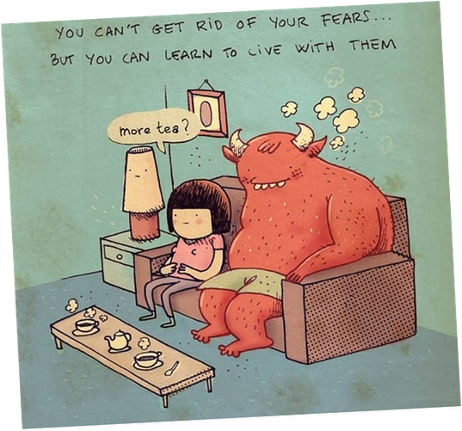
The Good, The Bad, & The Great
05
GOOD NEWS
BAD NEWS
GREAT NEWS
Imposter Syndrome is correlated with success!
Imposter Syndrome doesn't disappear with achievement
ACT can help!
25
#ACBSWC
20
15
10
5
0
SUCESS

Slide 6
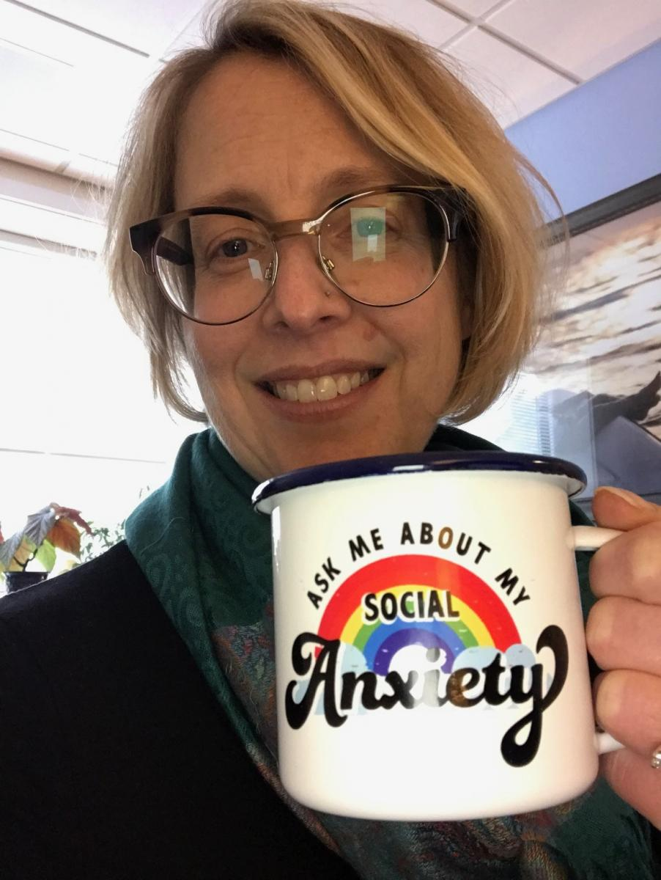
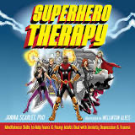
06
Fierce (but possibly fraudulent) Panelists
DR DEBBIE SORENSEN
DR JANINA SCARLET
DR LISA COYNE
DR MIRANDA MORRIS
#ACBSWC

Slide 7
07
Thank you!
QUESTIONS OR COMMENTS?
#ACBSWC

